Slide 1
AE704: Money
& Team Dynamics
A presentation by Robin Upton. 2014-02-02
Available from http://www.RobinUpton.com
Attribution – NonCommercial - ShareAlike
Notes:
<number>
<number>

Slide 2
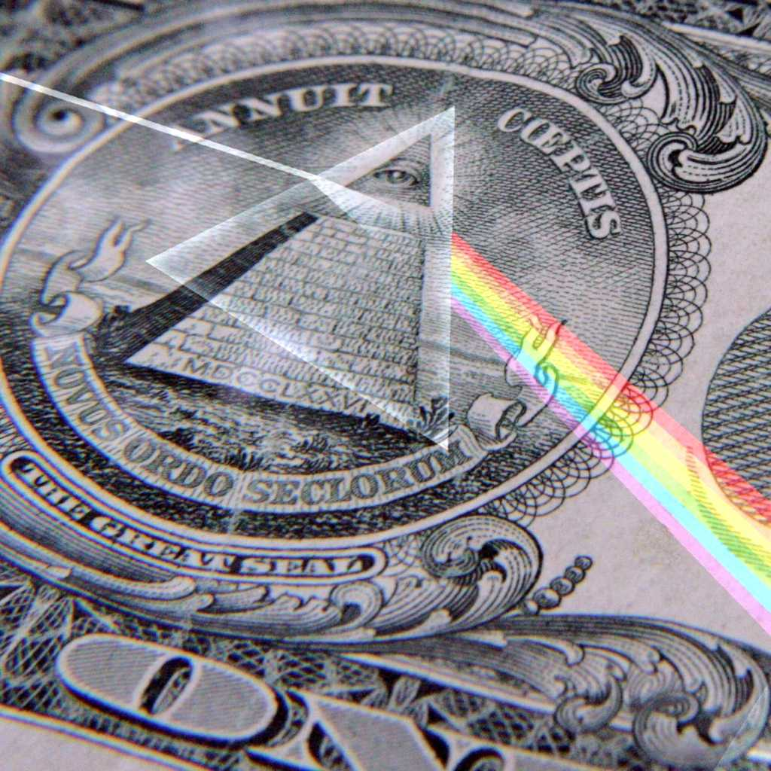
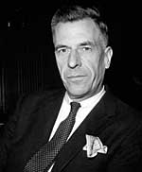
http://altruists.org/302
1. Money Fundamentals
“The process by which banks create money is so simple that
the mind is repelled.”
J.K. Galbraith, 20th Century Economist
Notes:
<number>
<number>

Slide 3
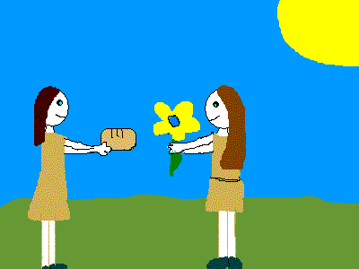
Money did not arise from barter!
“Almost all histories of money continue to begin with fanciful accounts of barter.”
Debt, The First 5000 Years (David Graeber)
Notes:
<number>
<number>

Slide 4

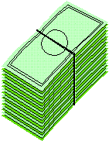

http://www.moneyasdebt.net
Banks lend money into existence
Money Creators
The need for interest increases total debt exponentially...
Money Users
Money use = debt Increases exponentially
Notes:
<number>
<number>

Slide 5
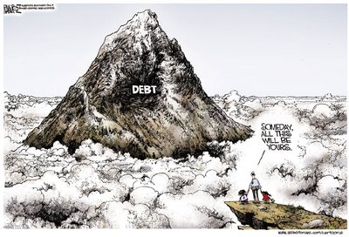

Slide 6


http://www.altruists.org/ideas/economics/problems/the_money_system/zero-sum/
More for you = less for me
$1
$2
$2
$1
Money naturalizes competition
Notes:
<number>
<number>

Slide 7
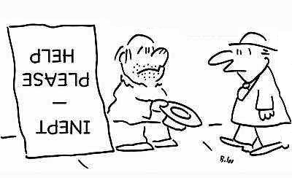
http://www.unwelcomeguests.net/505
Money ≈ Work done?
Rich
= Hard working, clever, productive
Poor
= Lazy, consumptive
Notes:
<number>
<number>

Slide 8
2. Money &
The Individual
Notes:
<number>
<number>

Slide 9

“Economic science”
“To economists, the real world is often a special case.”
Edgar Fiedler, 20th Century Economist
Notes:
<number>
<number>

Slide 10



Complex theory...
Supply & Demand
Discount Rate
Interest
“Cost of Living”
Inflation
Rational
Choice theory
Homo economicus
Prices
Money
...on simplistic assumptions?
Notes:
<number>
<number>

Slide 11
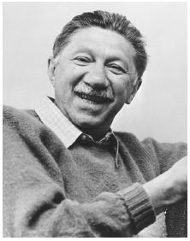
Unlikely (& Ugly!)
Assumptions of
Economics
“Classic economic theory [is based] on an inadequate theory of human motivation.”
Abraham Maslow, 20th Century Psychologist
Notes:
<number>
<number>
“Classic economic theory, based as it is on an inadequate theory of human motivation, could be revolutionized by accepting the reality of higher human needs, including the impulse to self-actualization and the love for the highest values.”

Slide 12
http://en.wikipedia.org/wiki/Homo_economicus
Homo economicus
An unlikely model of us humans:-
• Informed
• Rational
• Money-motivated
• Selfish
• Greedy
• Amoral
Notes:
<number>
<number>

Slide 13
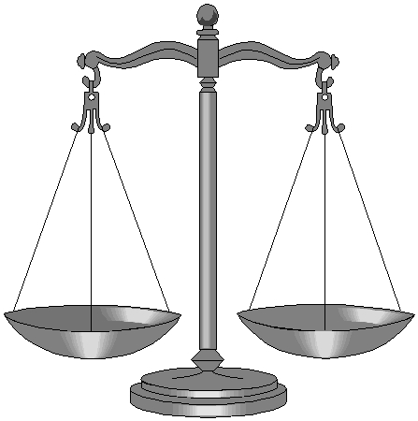

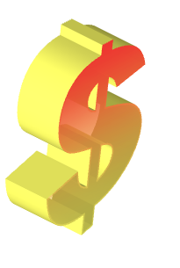
http://en.wikipedia.org/wiki/Cost-benefit_analysis
Cost benefit analysis
“Every man
has his price”
Profit
Loss
Anything is 'rational', if paid enough...
Notes:
<number>
<number>

Slide 14
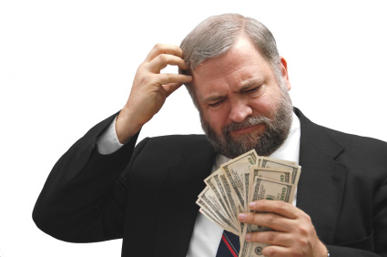
“Experimental economics”
The Dictator game (1980/90s):
Player 1 gets money...
...and may give some to player 2.
Notes:
<number>
<number>

Slide 15
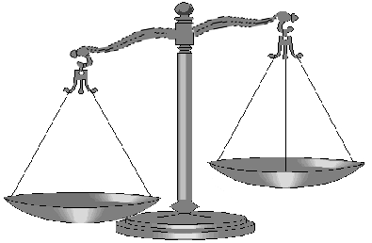
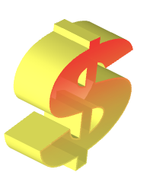

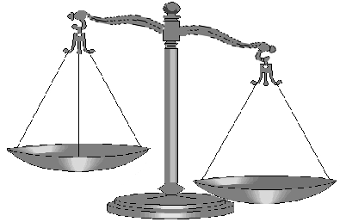


Moral Abridgement
= Good?
Profit
Loss
= Bad?
Notes:
<number>
<number>

Slide 16
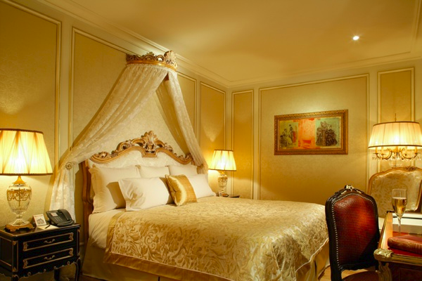
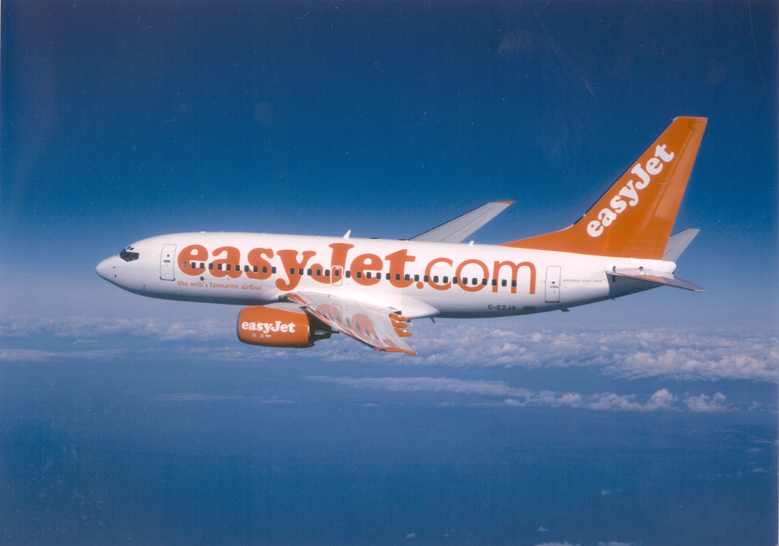
Money = entitlement?
Do you have a moral right
to what you can pay for?
Notes:
<number>
<number>

Slide 17
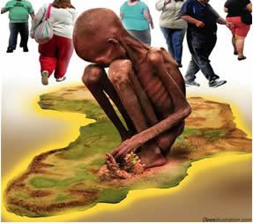
http://www.altuists.org/ae604
No money = no entitlement?
Do you have no moral right to what you cannot pay for?
Notes:
<number>
<number>
Note the subtle difference between “demand” (=what people want) and “effective demand” (= what people want and have money to pay for). Of course, when economists talk about supply matching demand, they’re only talking about “effective demand”.

Slide 18
Psychological
Impact of
Money
Abraham Maslow, 20th Century Psychologist
Notes:
<number>
<number>
“Classic economic theory, based as it is on an inadequate theory of human motivation, could be revolutionized by accepting the reality of higher human needs, including the impulse to self-actualization and the love for the highest values.”

Slide 19


Schooling reduces Self-direction
Training
Study to get marks
Work to get money

Slide 20
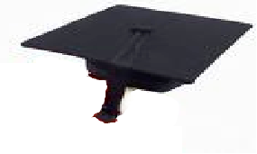

Subversion of Values
“Is a bank job a good job?”
“Economic Literacy” Exam:
Rationality =
Self-Interest
Thinking:
What’s in it for ME?

Slide 21


Money gradually erodes other values
`
“What are you going to do when you grow up?”
“I have to make a living somehow!”
Notes:
<number>
<number>

Slide 22


2009 Money/pain experiment
http://www.altruists.org/d997
Experimental subjects rated the pain of hot water:
Either
(A) After counting real bank notes
Or
(B) After counting blank paper
Group (A) felt less pain, especially when socially isolated!
Notes:
<number>
<number>
The Symbolic Power of Money - Reminders of Money Alter Social Distress and Physical Pain ( Xinyue Zhou, Kathleen Vohs & Roy Baumeister) – 2009 - Psychological Science 20 (Issue 6), pp.700-706

Slide 23
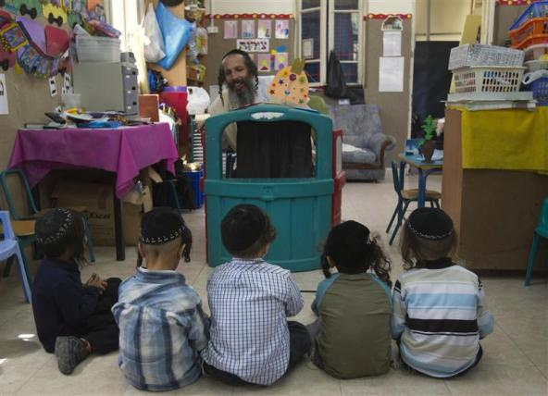
1998 - “A fine is a price” experiment
http://rady.ucsd.edu/faculty/directory/gneezy/pub/docs/fine.pdf
6/10 Kindergartens began to fine parents
who came late to pick up their kids.
Notes:
A Fine Is A Price (Uri Gneezy & Aldo Rusticini) – 2000b - Journal of Legal Studies 29, 1–17

Slide 24
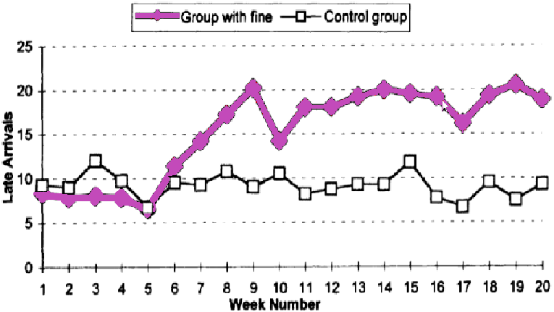
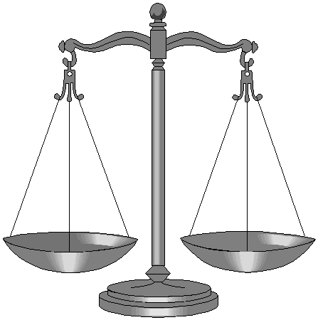
Average # late parents, per week
http://rady.ucsd.edu/faculty/directory/gneezy/pub/docs/fine.pdf
Fine for late pickup
Monetization can change attitudes
Notes:
A Fine Is A Price (Uri Gneezy & Aldo Rusticini) – 2000b - Journal of Legal Studies 29, 1–17

Slide 25
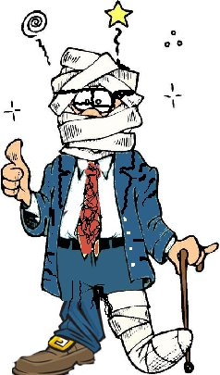


Corruption of Thinking
“ ...(Financial) Compensation...”
“How much
is he worth?”
+ =
=
The real world is equated to money

Slide 26
Stockholm syndrome?
“Does humanity need a
''way to force people to do things they don't want to do''* ?”
*
As a middle-class American once described money to me.
Notes:
<number>
<number>

Slide 27
3. Money & Organisations
Notes:
<number>
<number>

Slide 28
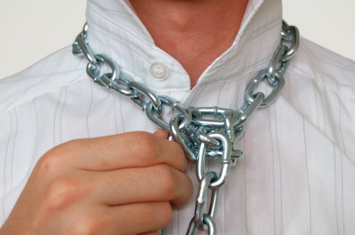
Money legitimises control
“He who pays the piper calls the tune.”
The (more virtuous) rich control the (less virtuous) poor
Notes:
<number>
<number>

Slide 29

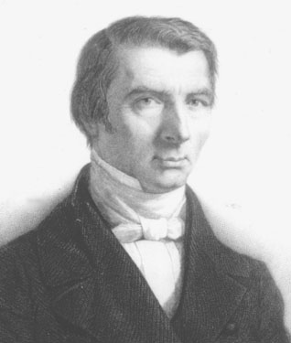
The Inside Story
Of Money
“When plunder becomes a way of life for a group of men in a society, over the course of time they create for themselves a legal system that authorizes it and a moral code that glorifies it.”
Frederic Bastiat, 19th Century Economist
```
Notes:
<number>
<number>

Slide 30
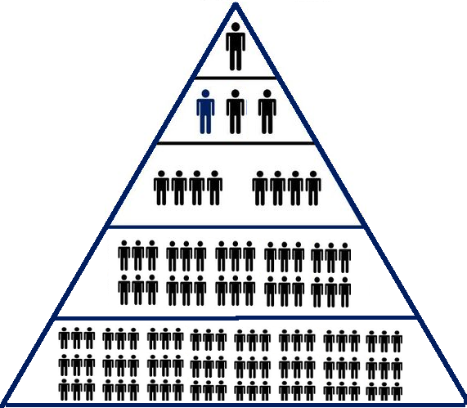

https://en.wikipedia.org/wiki/The_Corporation_(film)
Corporations promote psycho-/sociopaths
Selfish profit seeking promotes sociopathic behavior…
…while selecting for psychopathy of leadership.
Notes:
<number>
<number>

Slide 31

“It is hard for a rich man
to enter the kingdom of heaven.”
Matthew 19:23

Slide 32
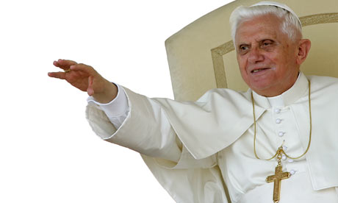
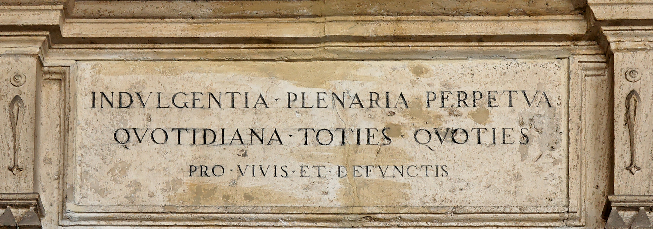
http://en.wikipedia.org/wiki/Indulgence
Subversion...
By the 13th Century,
Popes were selling 'indulgences'...
=Entry into Heaven, for a Price.

Slide 33
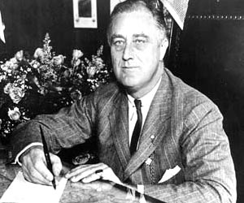
International
Impact of Money
“The real truth of the matter is, as you and I know, that a financial element in the larger centers has owned the Government ever since the days of Andrew Jackson.”
US President Franklin D. Roosevelt
writing to Colonel House 1933-10-21
Notes:
<number>
<number>

Slide 34
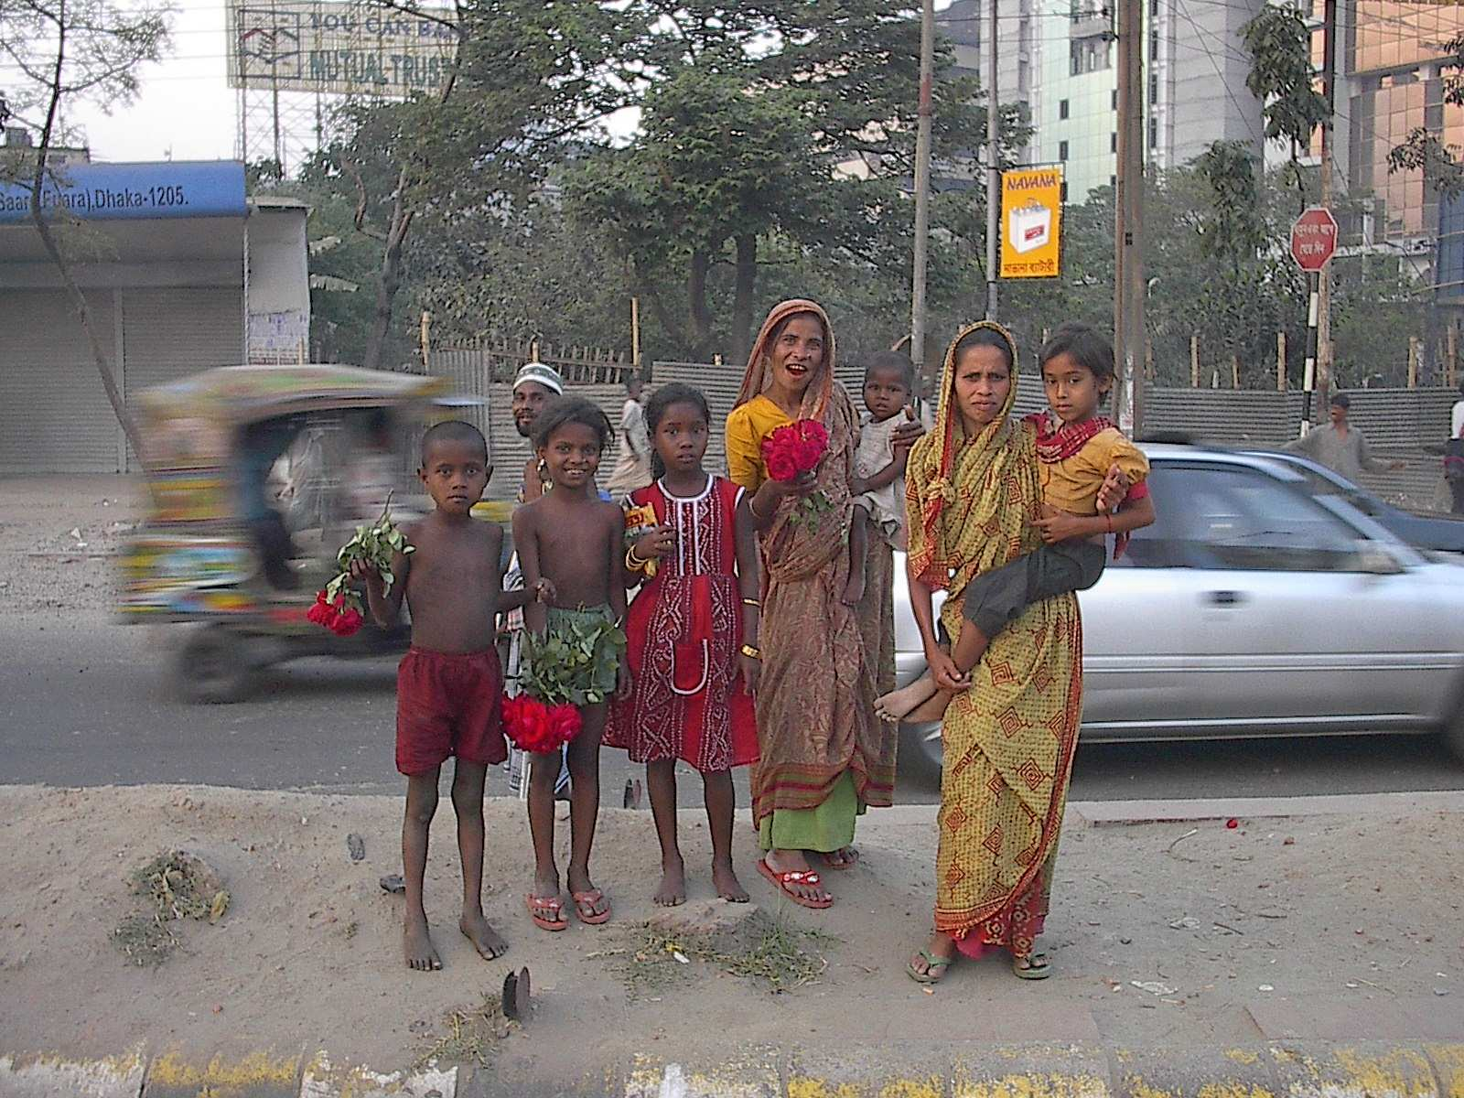
“Poor Countries”
...as if their main difference from
'rich countries' is a lack of money.

Slide 35
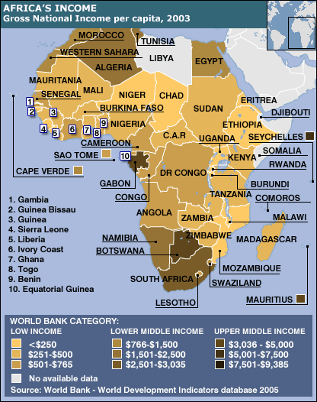
World Bank still defines
poverty in money terms...
...as if monetising life reduces poverty.

Slide 36
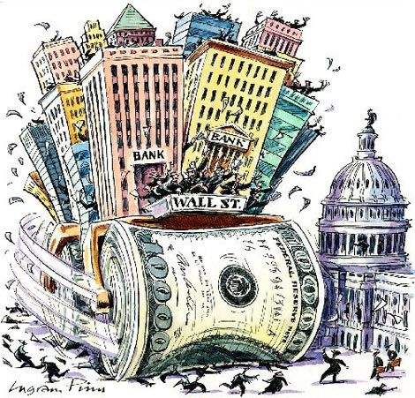
Regulatory capture
Government agencies which regulate big bu$ine$$...
...tend to attract the 'attention' of big bu$ine$$.
Notes:
<number>
<number>

Slide 37
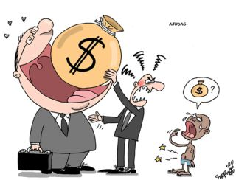
SELF-Maximisation = Psychopathy
Modern economics is psychopathic;
a zero-sum framework rewards a mass kill-off.

Slide 38
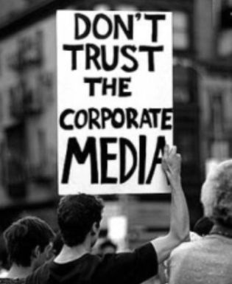
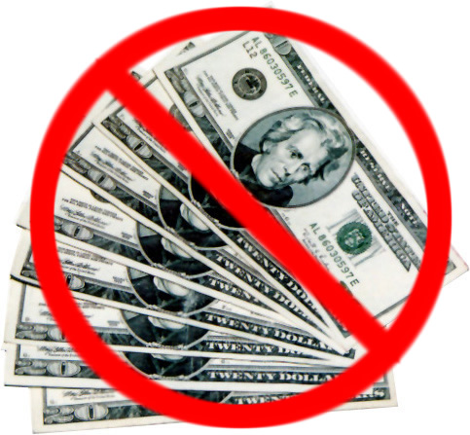
Avoid Money As Far As Possible
Work in the gift economy,
Avoid Bureaucracy,
Taxes, Regulations

Slide 39
4. Life
Beyond
Money
Notes:
<number>
<number>

Slide 40
Questioning assumptions
“What am I good at that is useful for other people, especially those in my immediate vicinty?”
“Does it matter that most people spend large parts of their lives doing things that they are not personally interested in?”
Would you rather work for love or money?
Notes:
<number>
<number>

Slide 41
What do you most enjoy giving?
“Are people naturally lazy...
or is laziness a reaction
to boring work?”
Notes:
<number>
<number>

Slide 42
Rethinking Money
“Does money
discourage or encourage
greed ?”
“He who loves money never has enough.”
Notes:
<number>
<number>

Slide 43
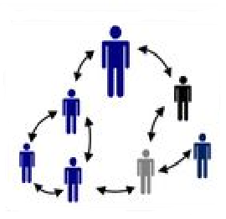
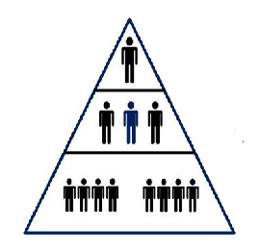
PLAY
WORK
`
Gift Economy
Bu$ine$$
More play less work?

Slide 44
Your calling?
“Who do I like working with?”
Try different things with/for different people
“What work do I find satisfying?”
Understand our parts of the whole
Notes:
<number>
<number>

Slide 45
Important Questions
“What am I good at that is useful for other people, especially those in my immediate vicinty?”
“What am I good at that is useful for other people, especially those in my immediate vicinity?”
“What do I need to allow me to help others?”

Slide 46
Rethinking needs
“How much do we* need?”
“How much of our own food do we grow?”
“How much of our own food do we grow?
What about water? Energy?”
Stock up, plan ahead!
Notes:
<number>
<number>

Slide 47
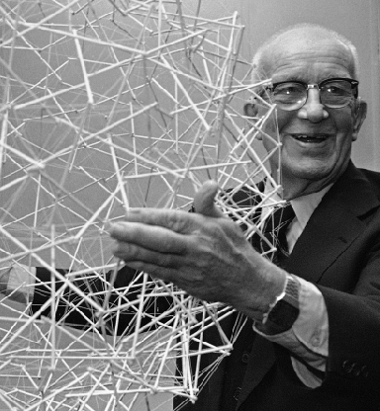
Who are WE...?
“Dare to think.
And to dare to go with the truth. And to dare to really love completely.”
Buckminster Fuller, 20th Century Visionary
Notes:
<number>
<number>

Slide 48
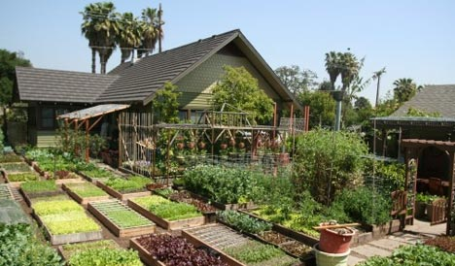
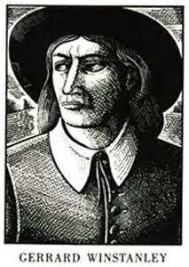
“We shall endeavour by our righteous acting not to leave the earth any longer intangled unto our children, by self-seeking proprietors; But to leave it a free store-house, and common treasury to all.”
`
Gerard Winstanley, 17th Century religious reformer

