Slide 1
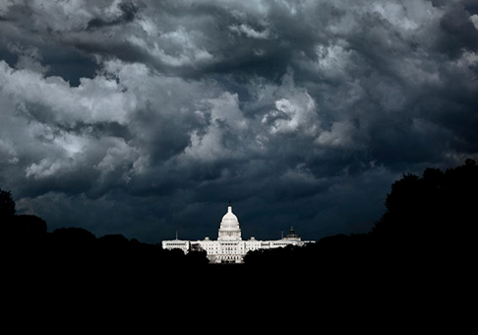
WS1:
Exploring
The Deep State
A presentation by
Robin Upton 2017-07-30
Ahttp://www.RobinUpton.com
Attribution – NonCommercial – ShareAlike
Notes:
<number>
<number>

Slide 2
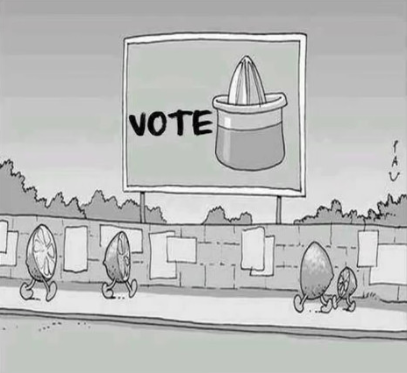
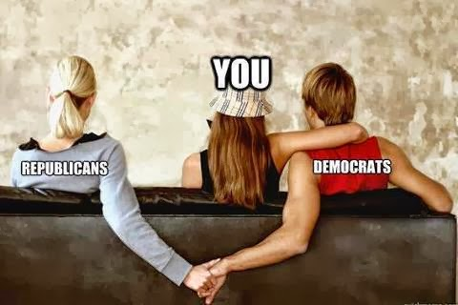
“Democratic” Party Politics

Slide 3
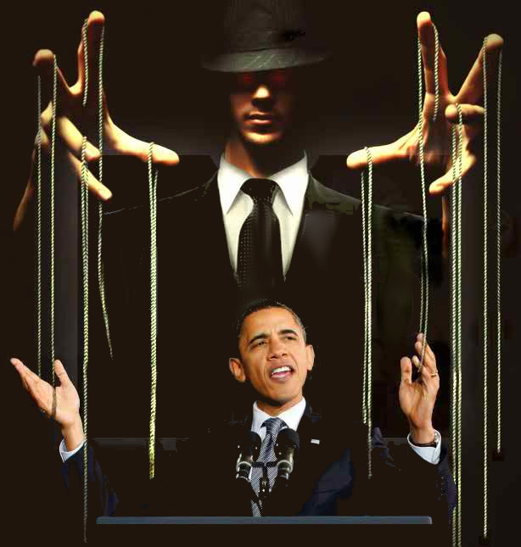
Political “Leaders”

Slide 4
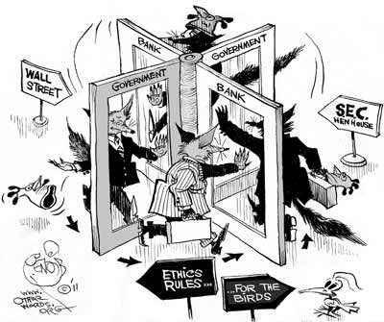
“Separation Of Powers”

Slide 5
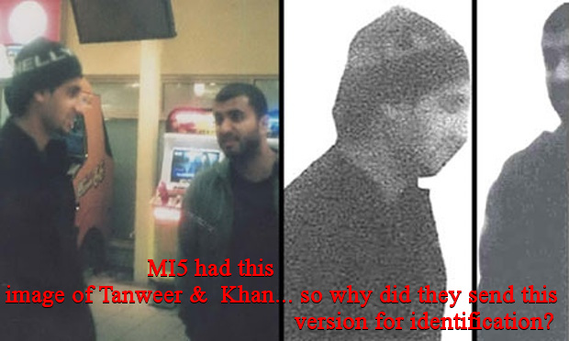
“Security Services”
No effective oversight!

Slide 6
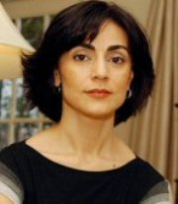
Blackmail
“[The deep state] want to make sure that only blackmailable candidates get to hold office…
If you’re squeaky clean, and if you start running for a major seat/position the chances are you’re not going to get there because…
they don’t want you there – they can not put pressure on you via blackmail.”
Sibel Edmonds
(Ex FBI translator)
“Most gagged person in the history of the USA.”

Slide 7
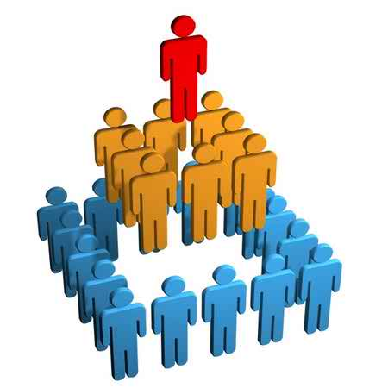
The Macleod Hierarchy
Psychopaths
Clueless
Losers

Slide 8
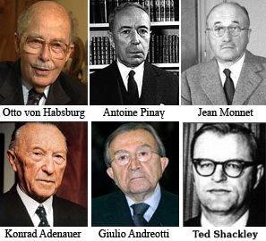
Deep State Milieux
Bilderberg,
Council on Foreign Relations,
Trilateral commission...
Le Cercle,
The Pilgrims,
Club de Berne,
Munich Security Conference...

Slide 9
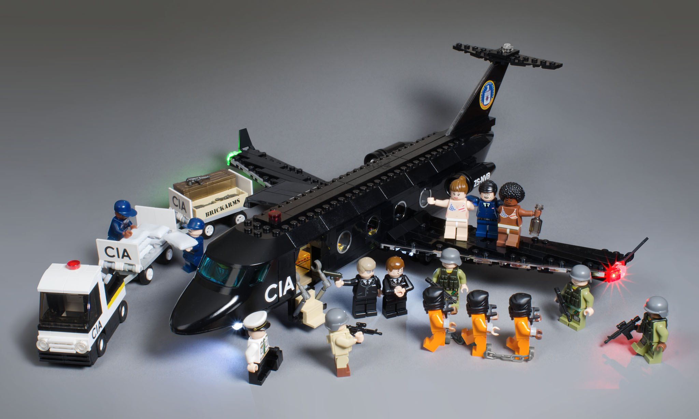
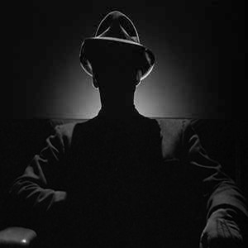
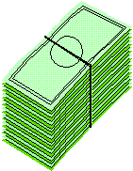
Black Budgets
No oversight of off-the-books ops
Official Activities
Black
Ops

Slide 10
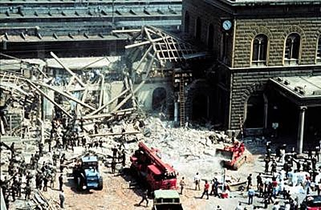
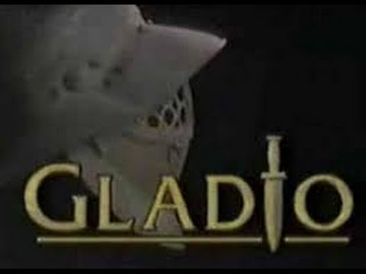
Operation Gladio
c.1945 - ...
Hundreds of civilians killed & injured by NATO bombs
1993 expose by
Alan Francovich
(on BBC2!)

Slide 11
Bilderberg Appointments
Howard Wilson, Edward Heath, James Callaghan,
Margaret Thatcher, Gordon Brown, Tony Blair...
became party leader before becoming PM,
but after attending the Bilderberg.
1966 – Discuss restructuring NATO
All permanent Secretaries General were
appointed after attending the Bilderberg.

Slide 12
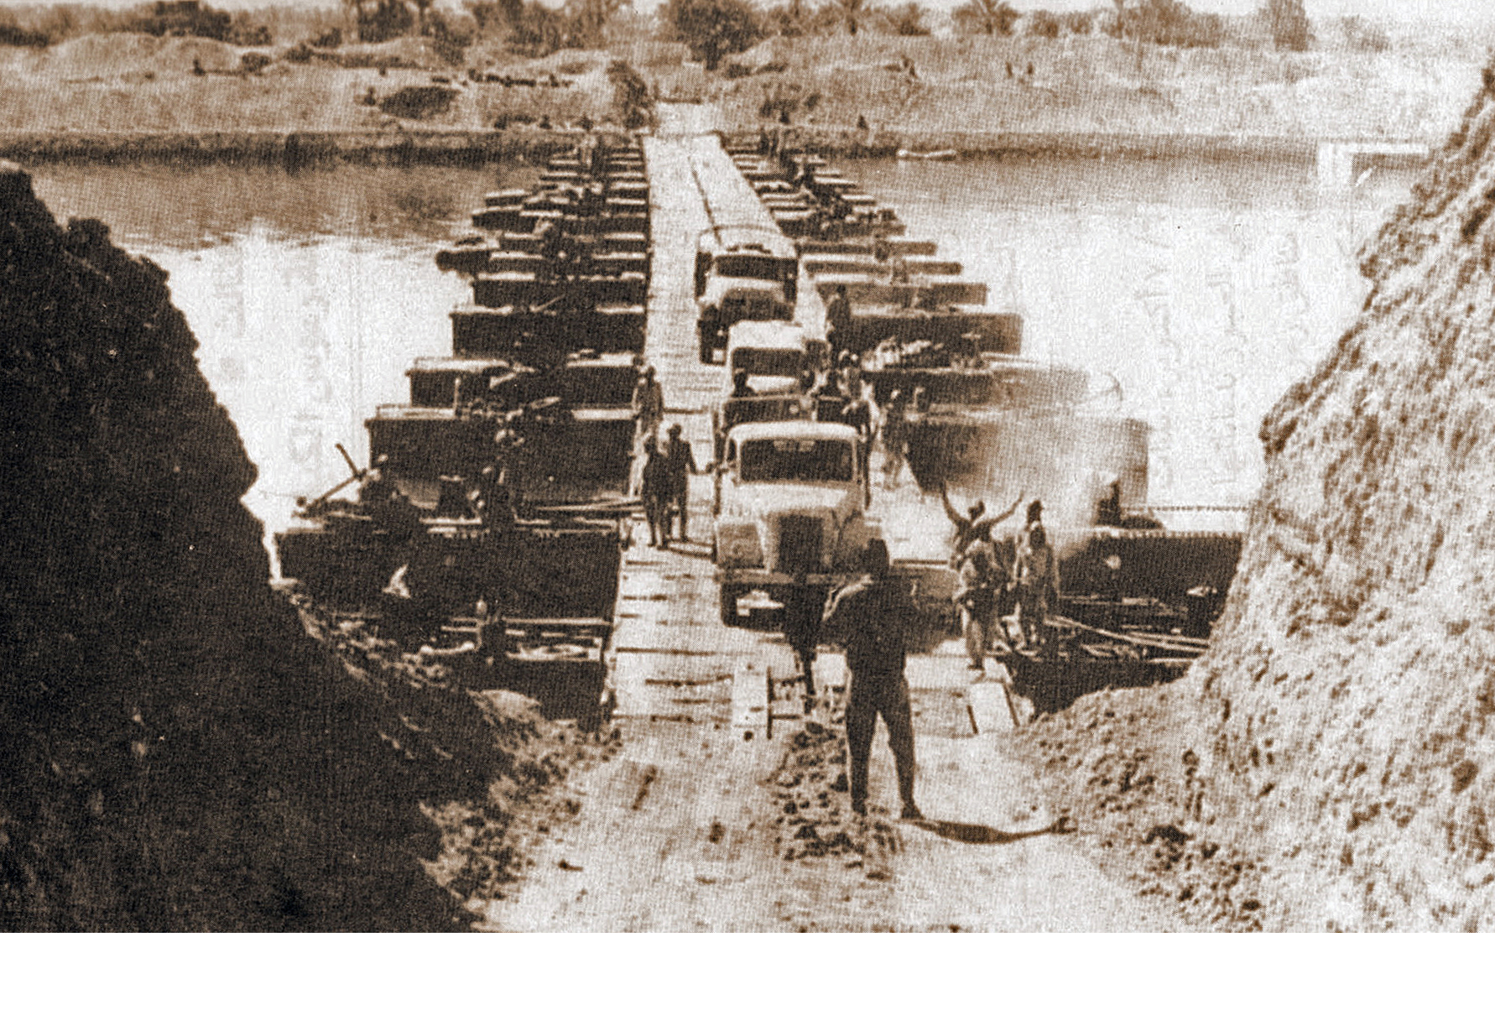
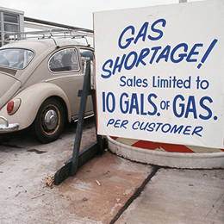
1973 Bilderberg
May: Bankers/Oil Execs meet to discuss oil pricing policy.
Yom Kippur War
6-25 October
“Oil Crisis”
~400% price hike

Slide 13
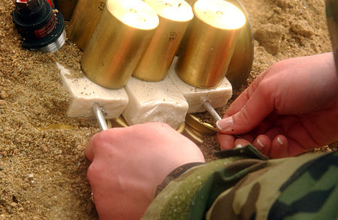
Arms For Libya
Late 1970s – Early 1980s
Edwin Wilson sells US plastic explosive stockpile (20 tons) to Libya,
with bomb making training, guns, etc.

Slide 14
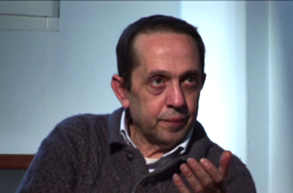
“Terrorism”
= Ill defined enemy image to promote fear.
"You had to attack civilians, the people, women, children, innocent people, unknown people far removed from any political game. The reason was quite simple. They were supposed to force these people, the Italian public to turn to the State to ask for greater security."
Vincenzo Vinciguerra
(NATO/Gladio bomber)
Speaking at his trial

Slide 15
“Counter-Terrorism”
Clique of “terrorologists”
on big media
`

Slide 16
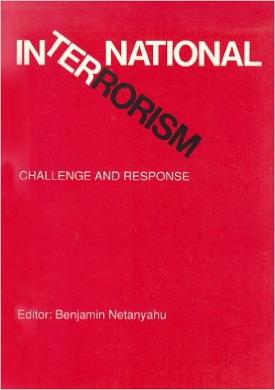
1979 Jerusalem Conference on International Terrorism (JCIT)
“Anti-Terror” expert speakers included:
George H.W. Bush,
Benjamin Netenyahu,
Brian Crozier
(Chairman of Le Cercle),
& other Cercle members...

Slide 17
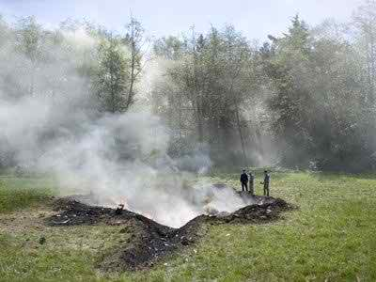
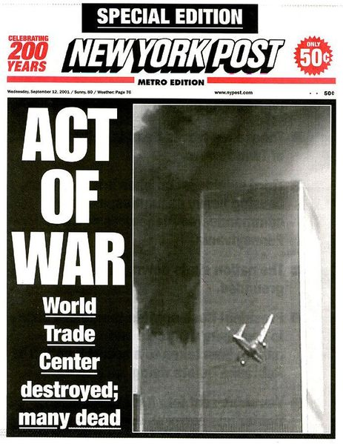
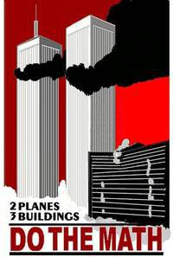
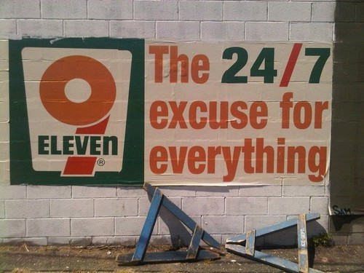
11th September 2001 : A Touchstone

Slide 18
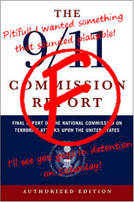
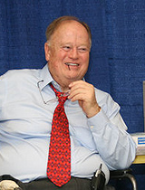
Two Official “Investigations”
"the White House has played cover-up."
Max Cleland
(US Senator)
Resigned from the 9/11 Commission

Slide 19
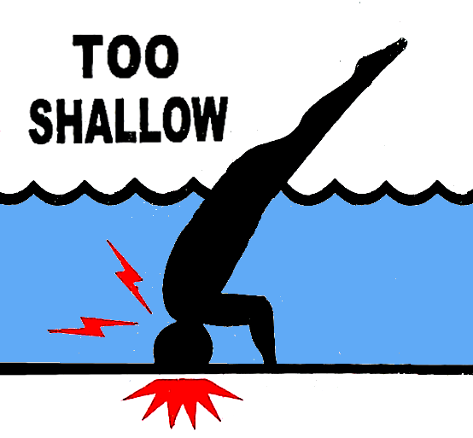
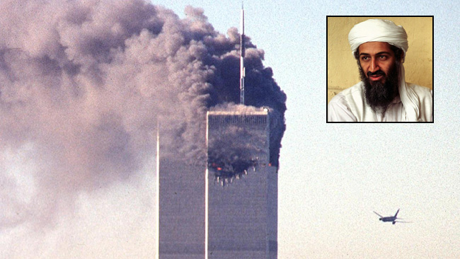
“Mainstream” Media
Corporate media is centralised, so vulnerable to deep state control
“Early in life I have noticed that no event is ever correctly reported in a newspaper.”
George Orwell

Slide 20
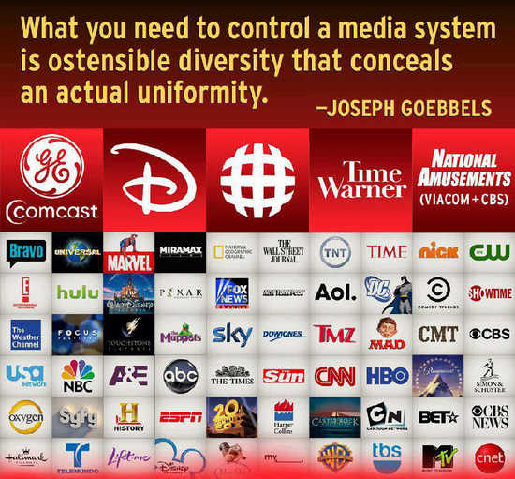
“Mainstream”
Corporate Controlled Media

Slide 21
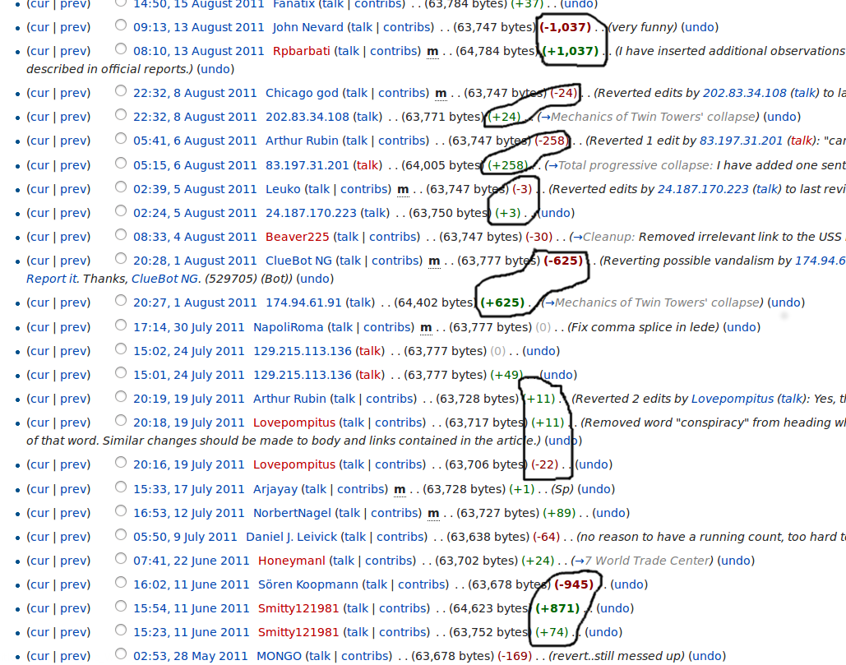
Wikipedia Page History
Edits are censored since ~2014

Slide 22
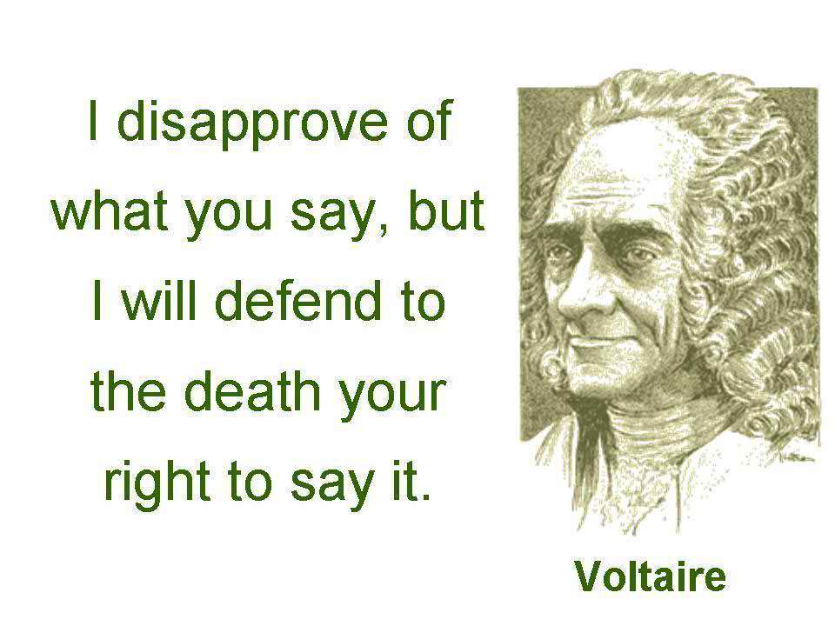
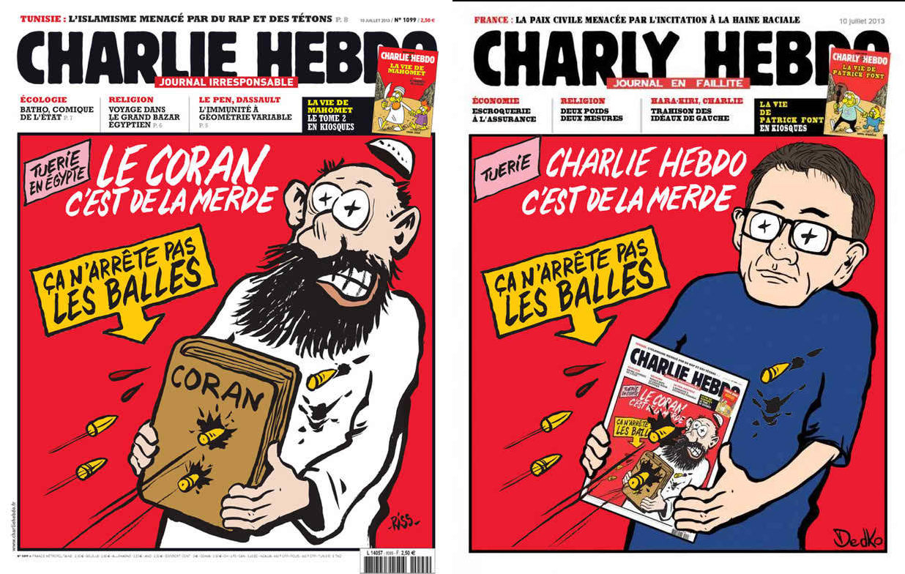
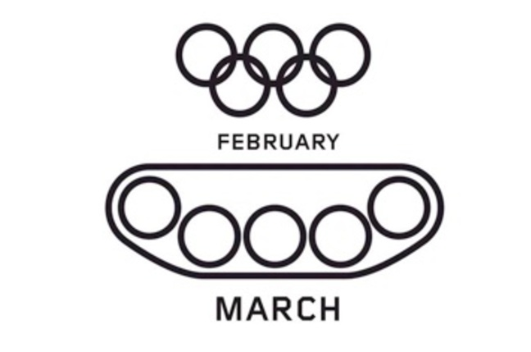
Calls to Censor “Extremist” Messages
Islamophobia exploited to undermine free speech on the internet

Slide 23
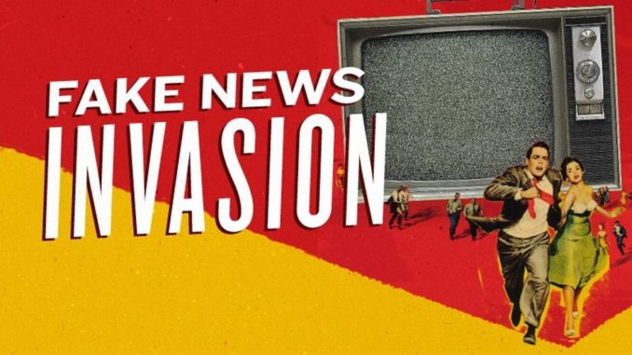
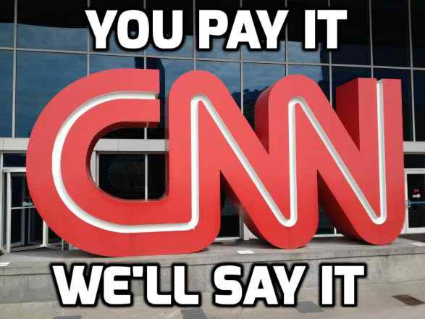
November 2017 - “Fake News”
“Fake News Website” → “Fake News”

Slide 24
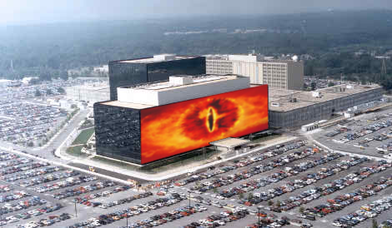
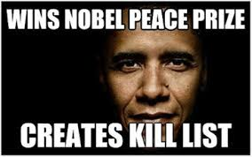
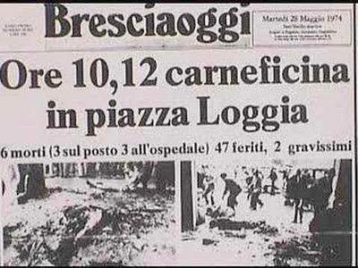
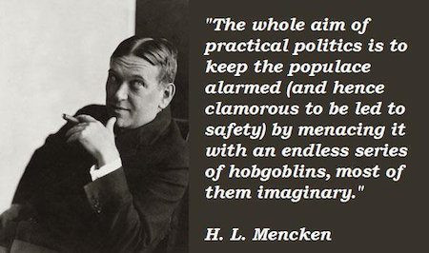
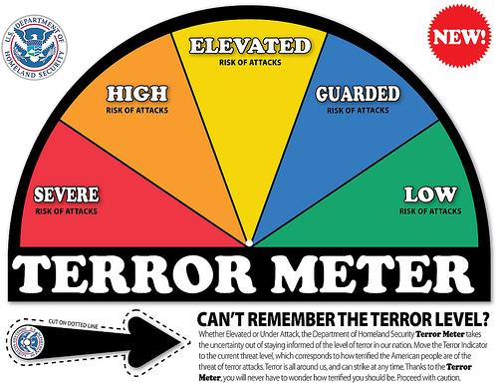
Strategy Of Tension

Slide 25
WikiSpooks.com 2017
Freely downloadable
Age: 7 years
Pages: 13,364
Documents: 1,399
Size: 4 GB
Editors: 574
Active Editors: ~10

